Slide 1

Sprint 1
Traffic Light System

Slide 2
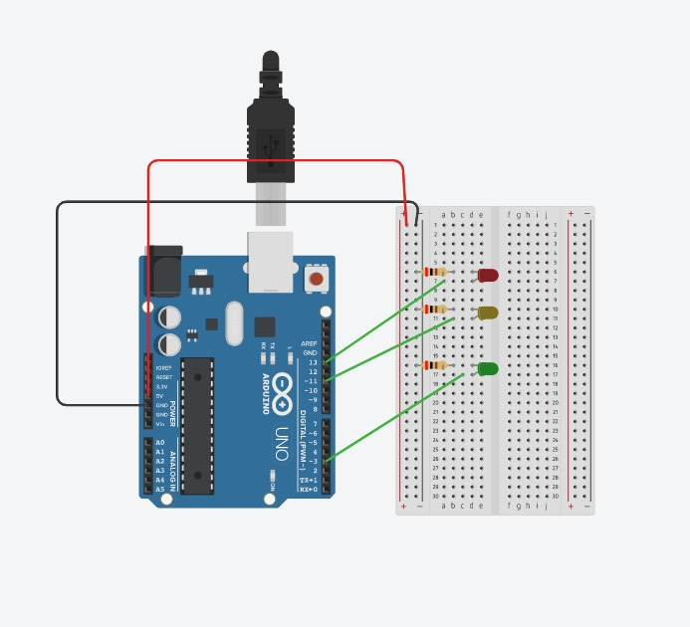
Circuit Diagram

Slide 3
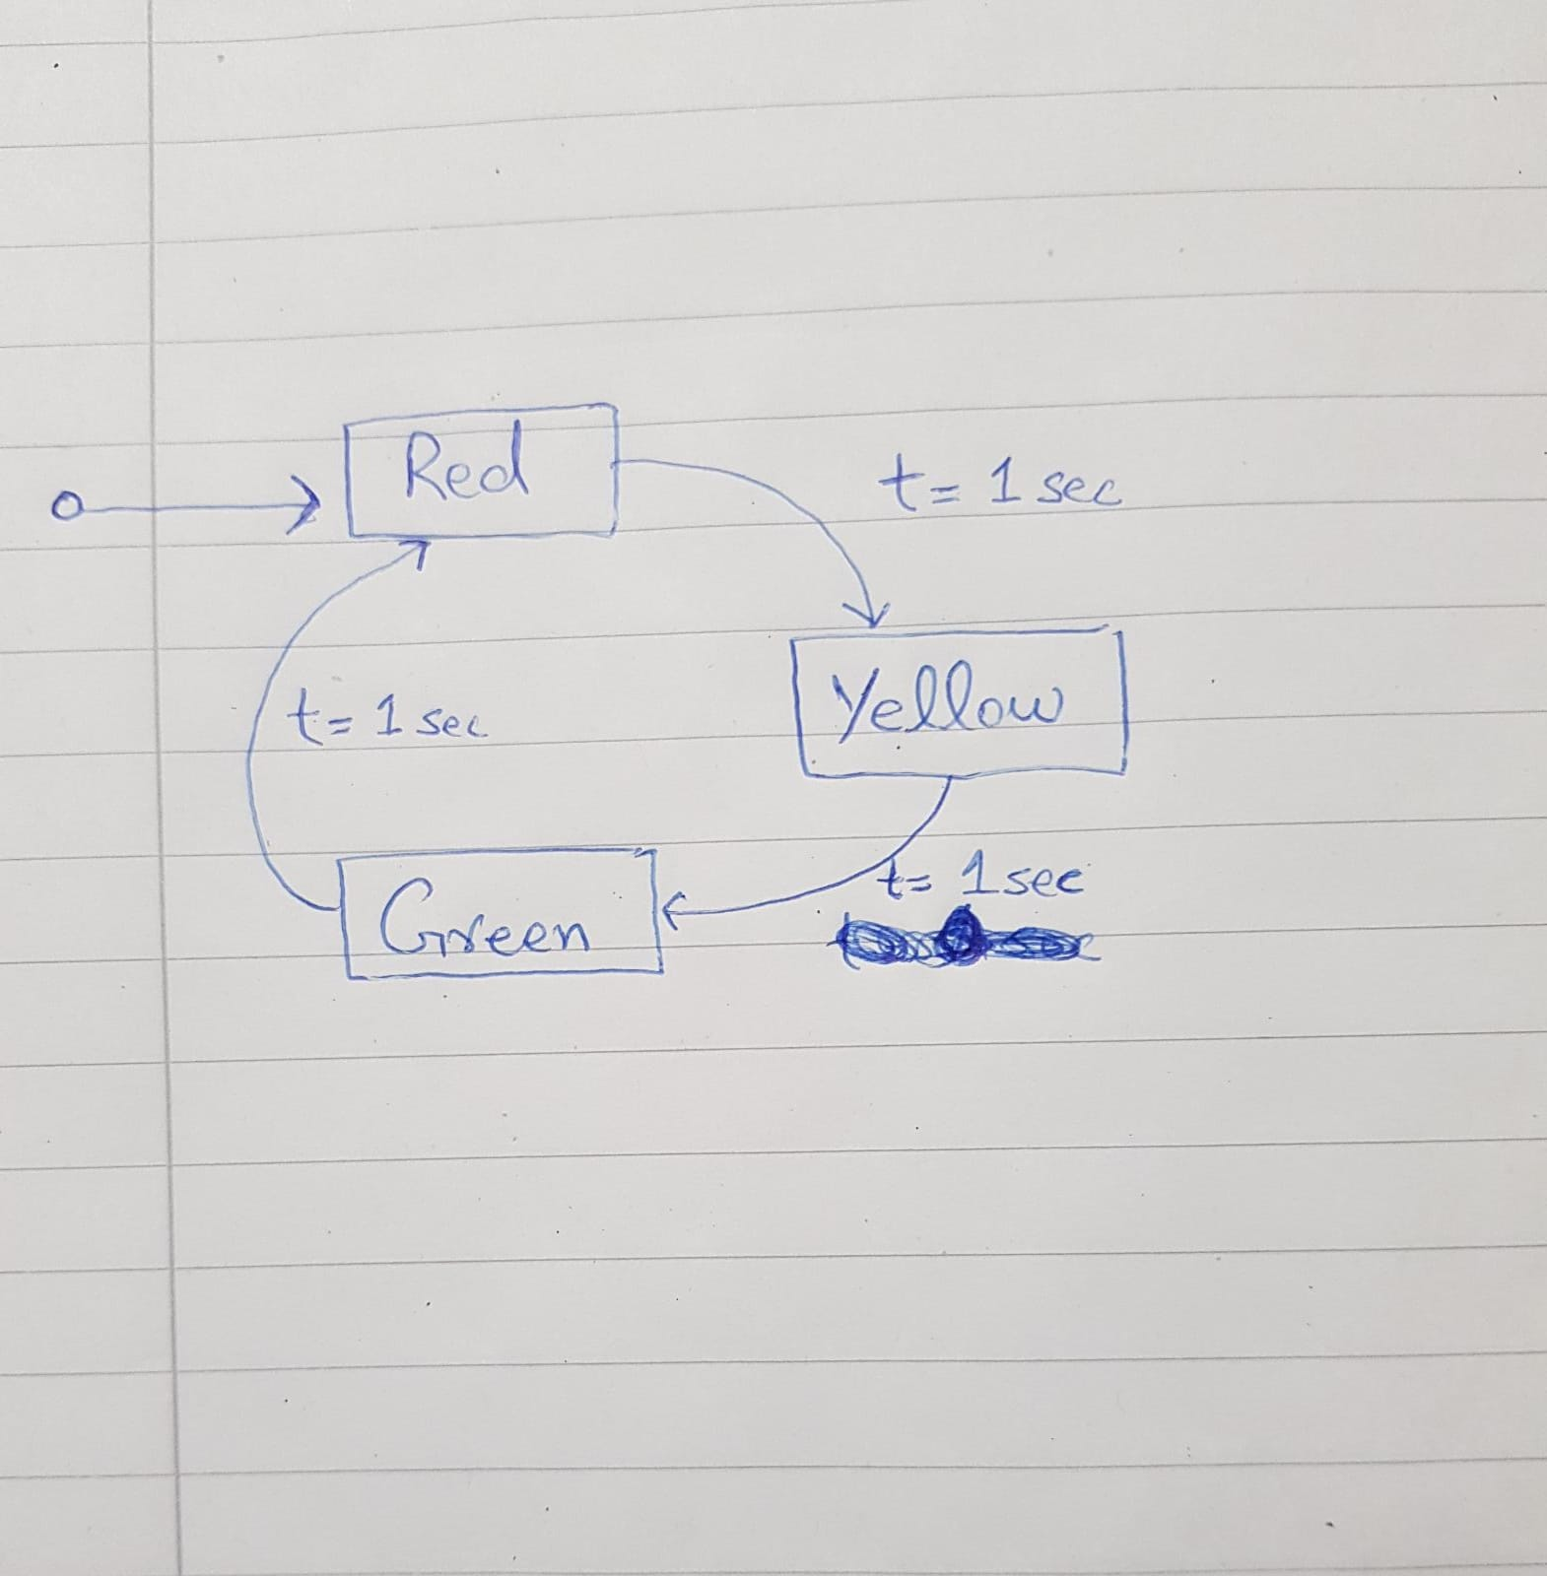
UML Diagram

Slide 4
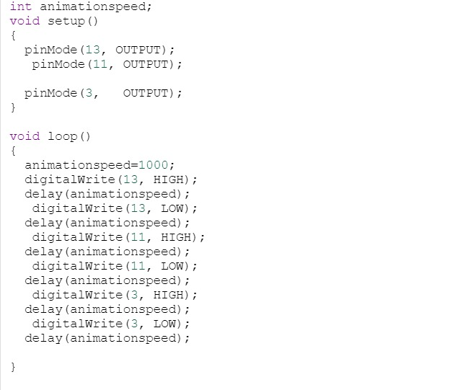
CODE

